Slide 1
Install git heroku rails
จัดทำโดย รัชวดี เวียนติง 57160431

Slide 2
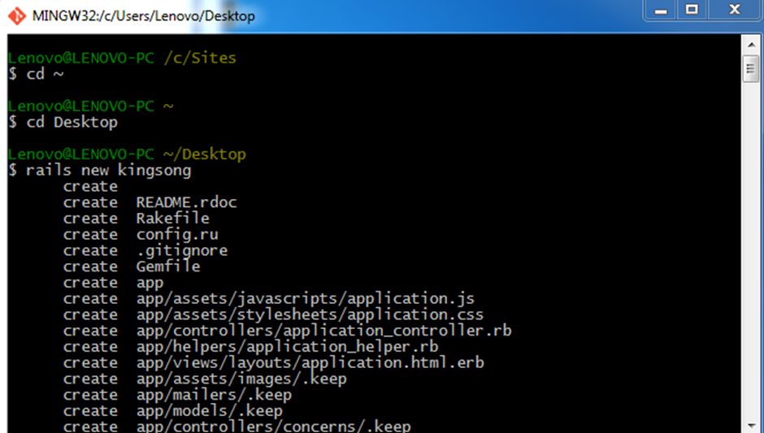
1. Go to desktop 2. rails new kingsong

Slide 3
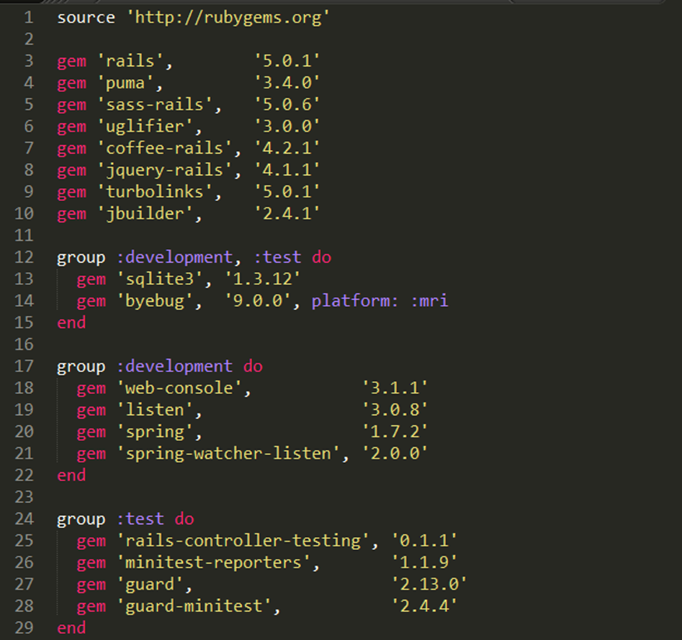
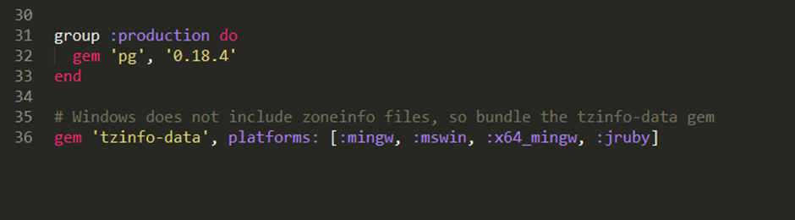
3. change Gemfile

Slide 4
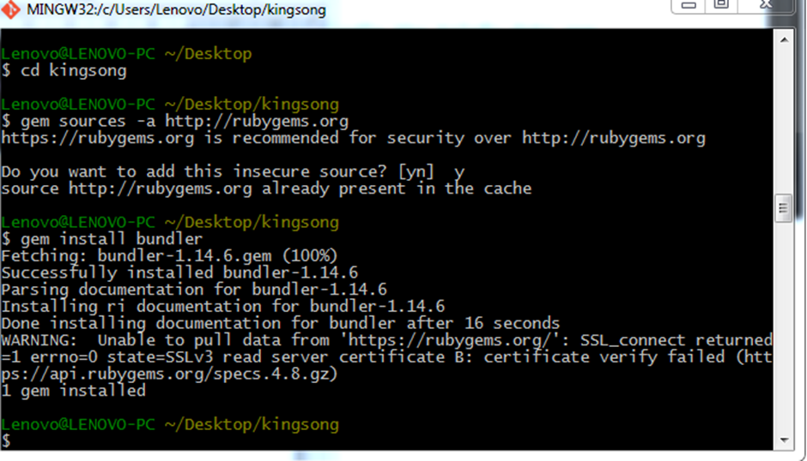
4. cd kingsong 5. gem sources –a http://rubygems.org 6. answer y 7. gem install bundler

Slide 5
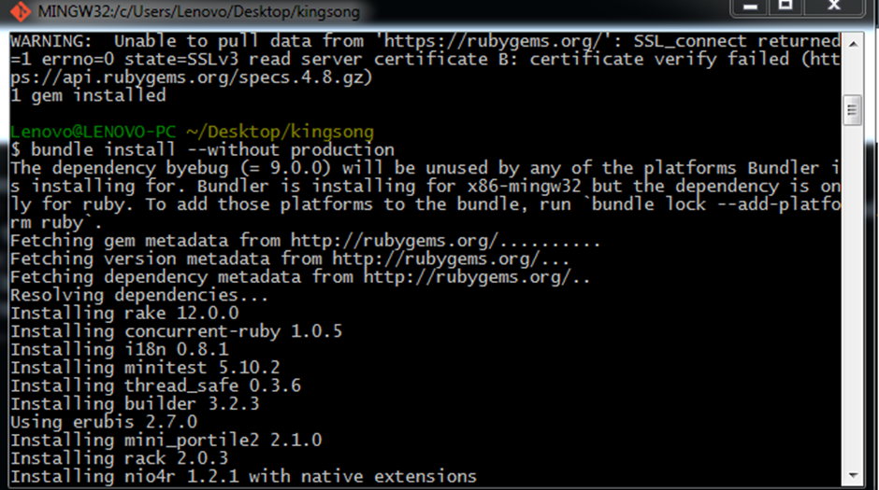
8. bundle install --without production

Slide 6
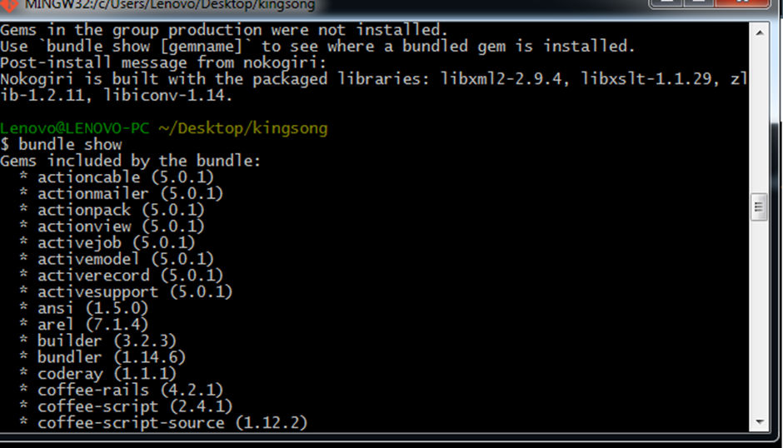
9. bundle show

Slide 7
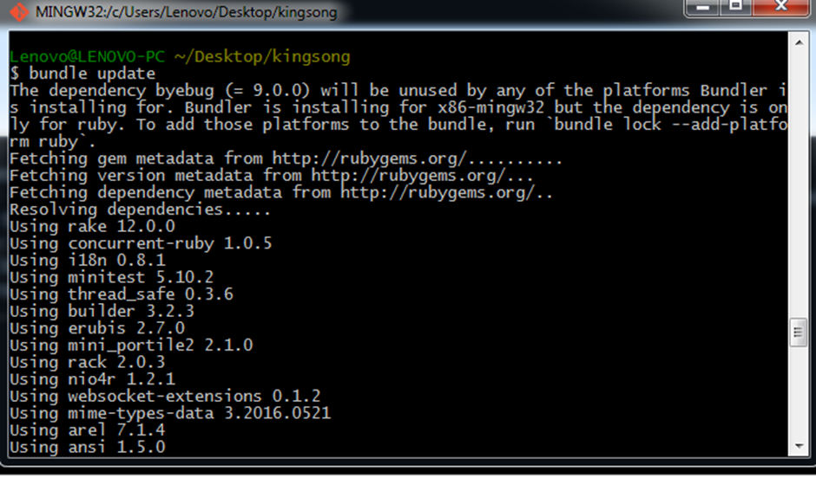
10. bundle update

Slide 8
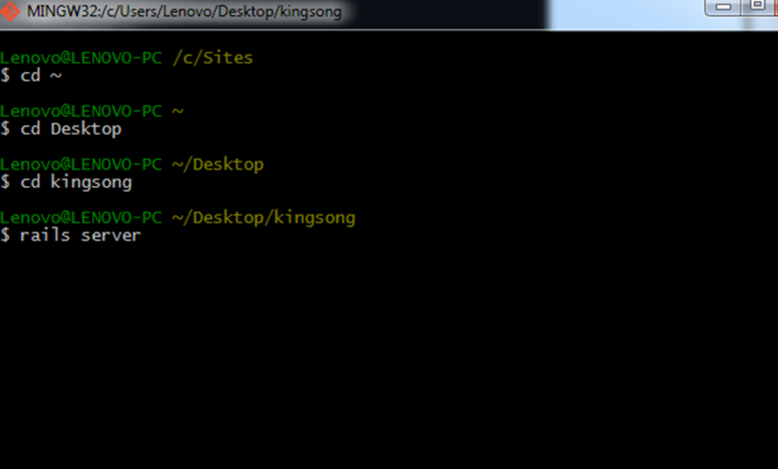
11. open cmd run rails server

Slide 9
12. open localhost:3000 will see welcome rails

Slide 10
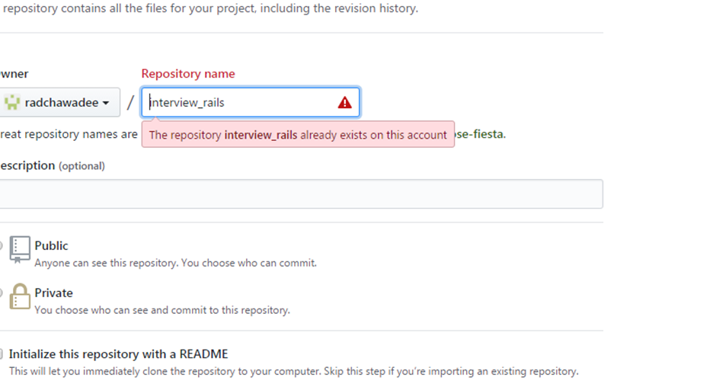
13. create repo at github

Slide 11
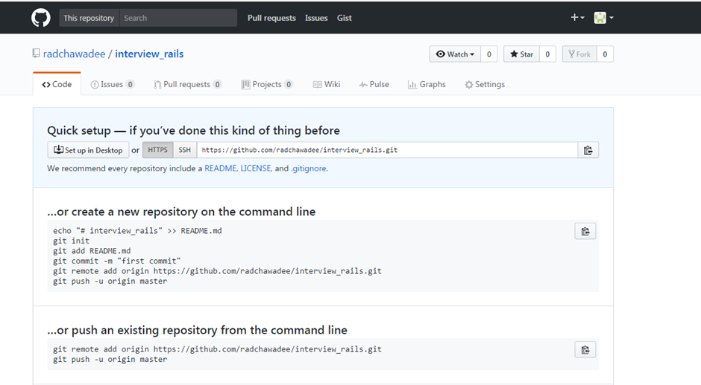
13. create repo at githubg(ต่อ)

Slide 12
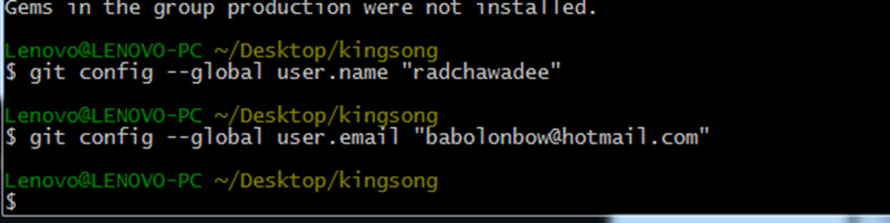
14. git config --global user.name "your username" 15. git config --global user.email "your email"

Slide 13
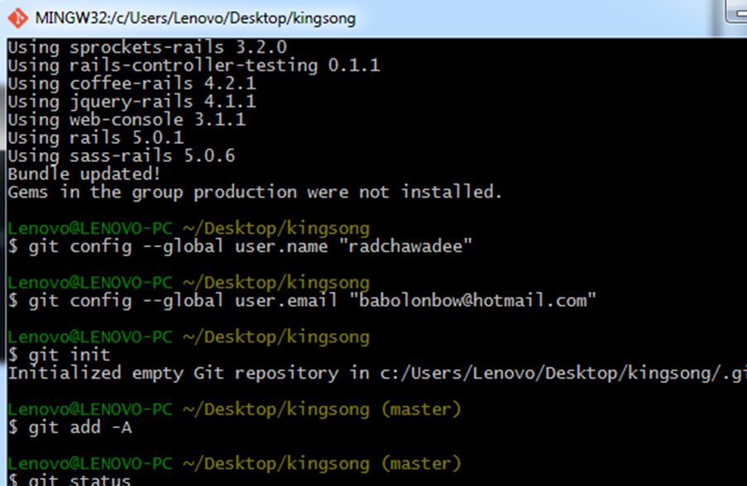
16. git init 17. git add –A (**A only**) 18. git status

Slide 14
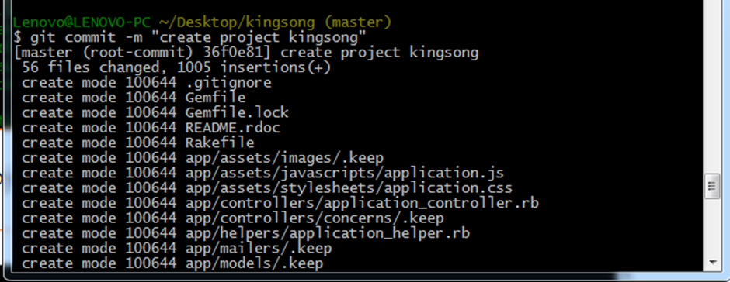
19. git commit –m “create project kingsong”

Slide 15
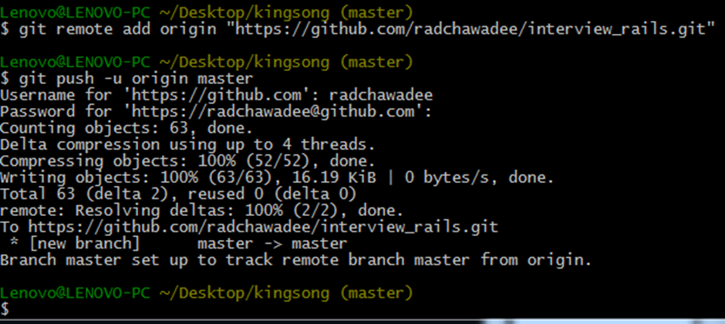
20. git remote add origin “git repo” 21. git push -u origin master

Slide 16
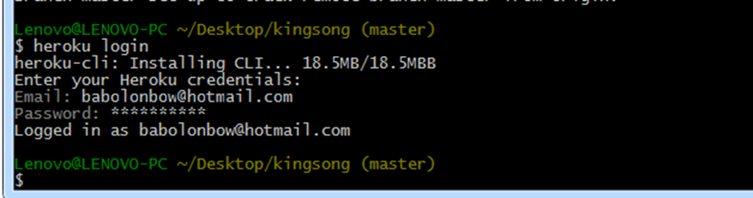
22. heroku login

Slide 17
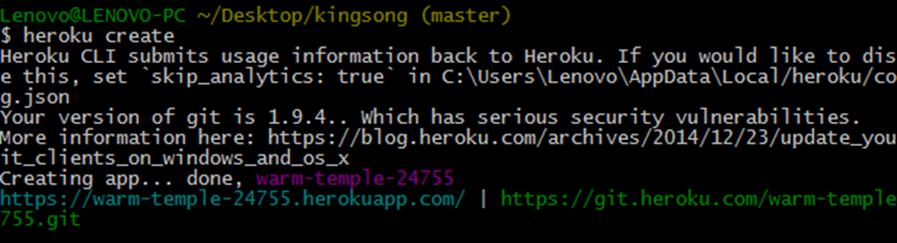
23. heroku create (heroku free 5 app)

Slide 18
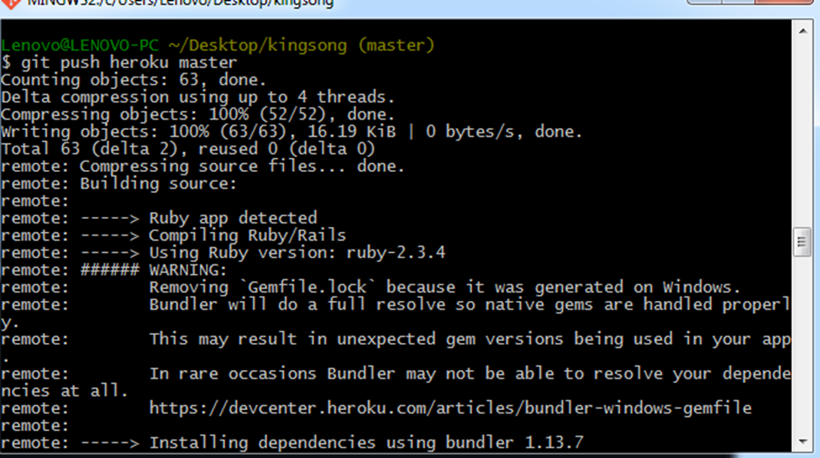
24. git push heroku master

Slide 19
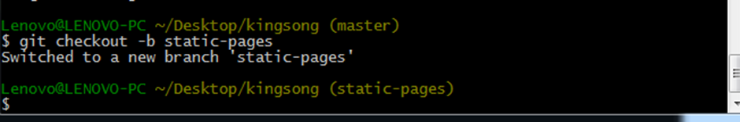
25. git checkout -b static-pages

Slide 20
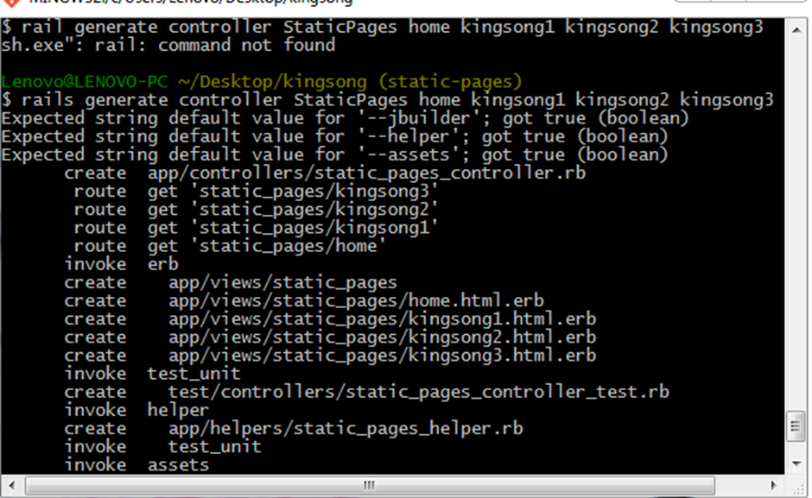
26. rails generate controller StaticPages home kingsong1 kingsong2 kingsong3

Slide 21
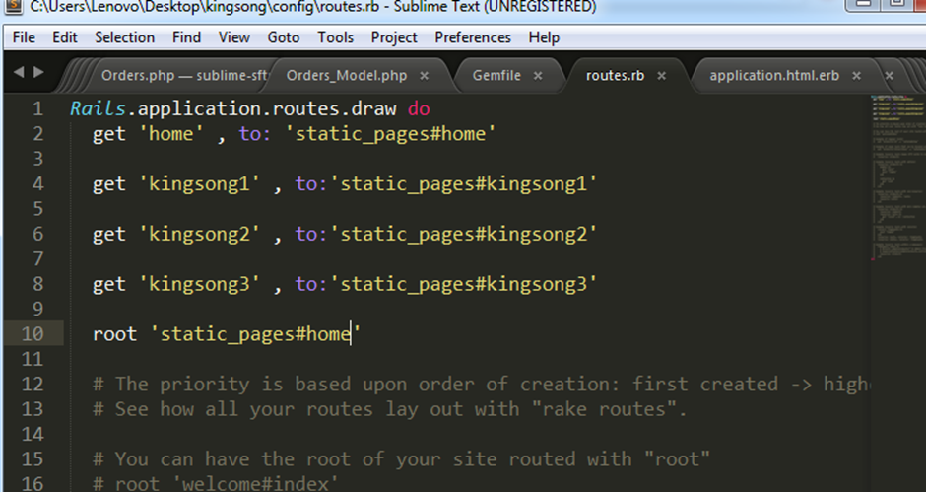
27. edit config/routes

Slide 22
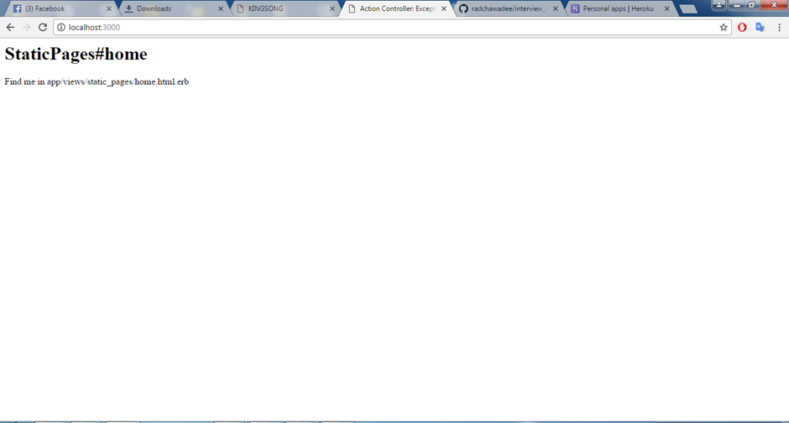
28. Look localhost:3000

Slide 23
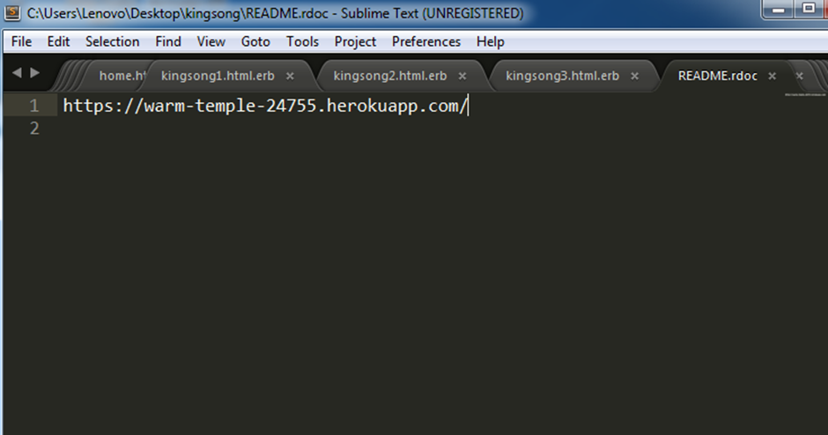
29. Edit app/views/static_pages/home.html.erb 30. Edit app/views/static_pages/kingsong1.html.erb 31. Edit app/views/static_pages/ kingsong2.html.erb 32. Edit app/views/static_pages/ kingsong3.html.erb 33. Edit Readme

Slide 24
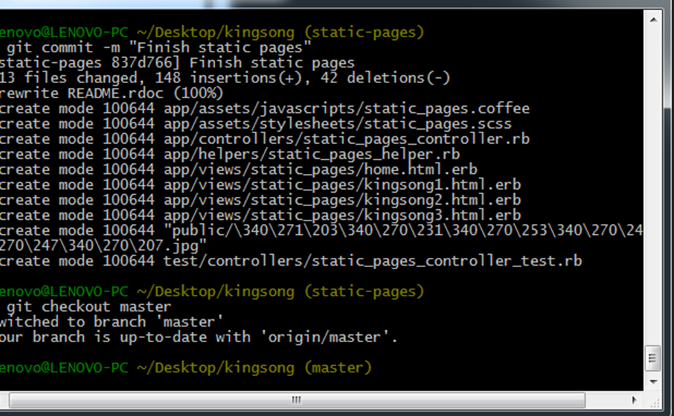
34. git add –A 35. git commit -m "Finish static pages" 36. git checkout master

Slide 25
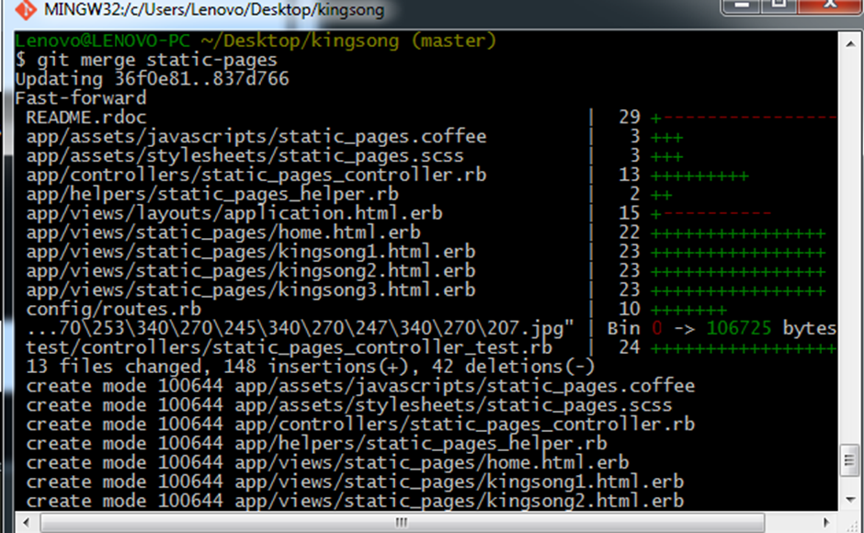
37. git merge static-pages

Slide 26
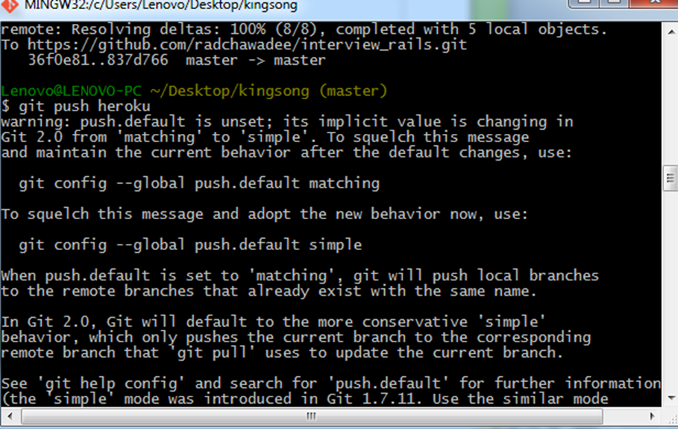
38. git push 39. git push heroku

Slide 27
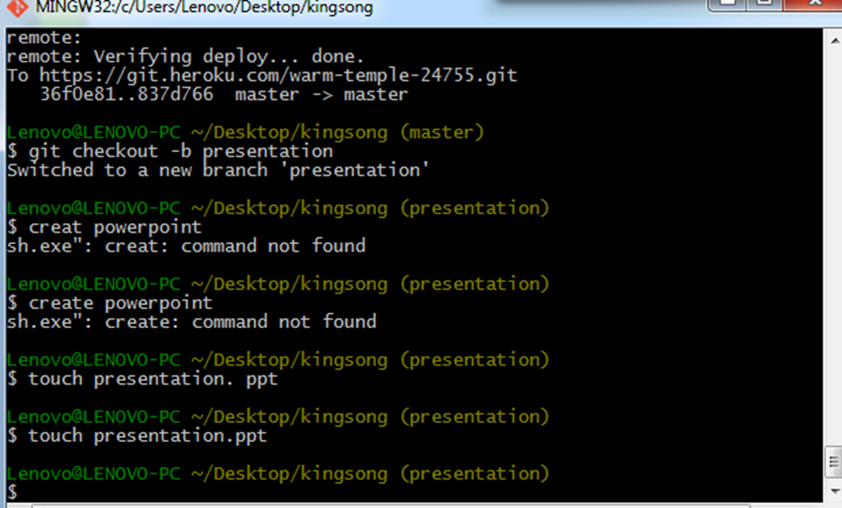
40. git checkout –b presentation 41. create powerpoint

Slide 28
43. git add –A 44. git commit -m "Finish presentation" 45. git checkout master 46. git merge presentation 47. git push

